Slide 1
Distributed Digital Preservation
Self-Audit Methods
Matt Schultz, Collaborative Services Librarian
Educopia Institute, MetaArchive Cooperative
ALA Midwinter 2010, Boston, MA
© Matt Schultz under a Creative Commons Attribution-Noncommercial-No Derivative Works 3.0 United States License
Notes:
*

Slide 2
Overview
Auditor Background
LOCKSS & MetaArchive
Trusted Repositories Audit & Certification (TRAC)
TRAC Audit Process
Preparation
Investigation
Discussion
Questions?
MetaArchive 2010
*
Notes:
*

Slide 3
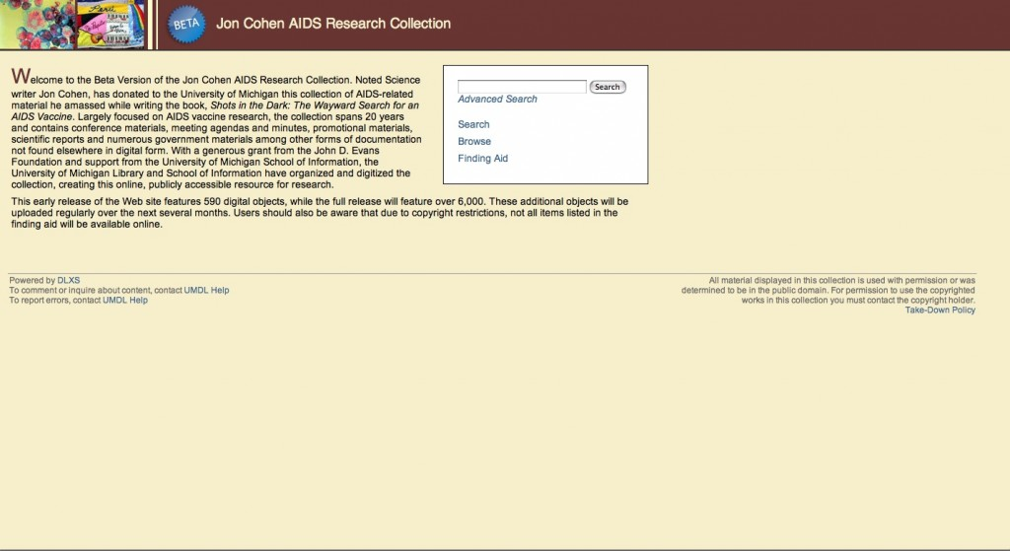
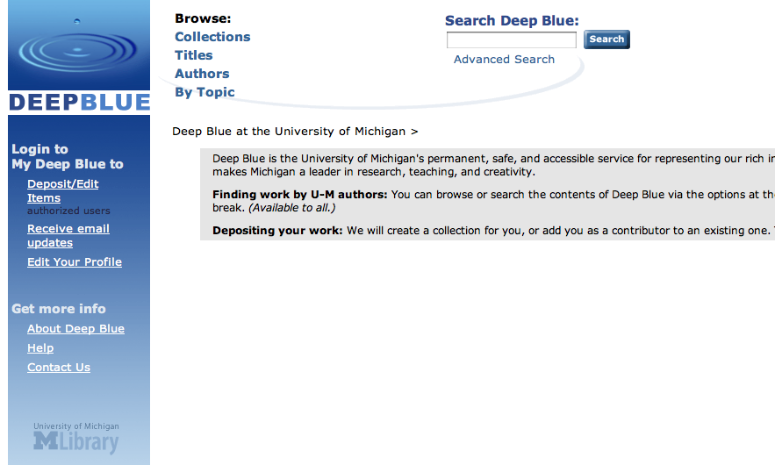
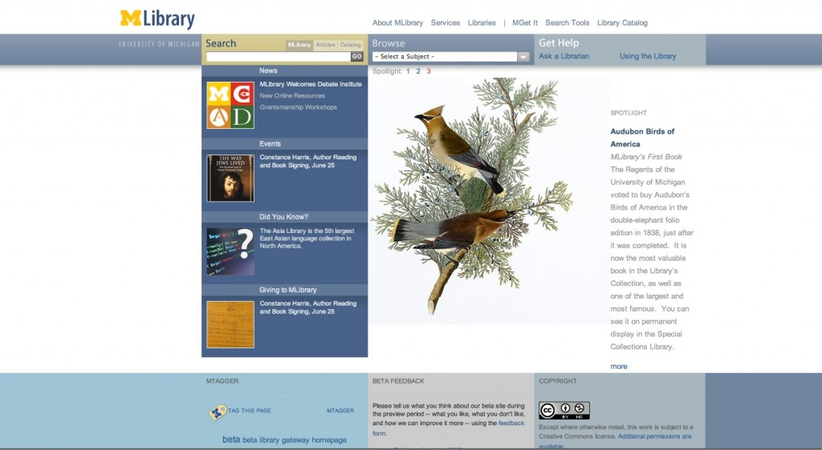
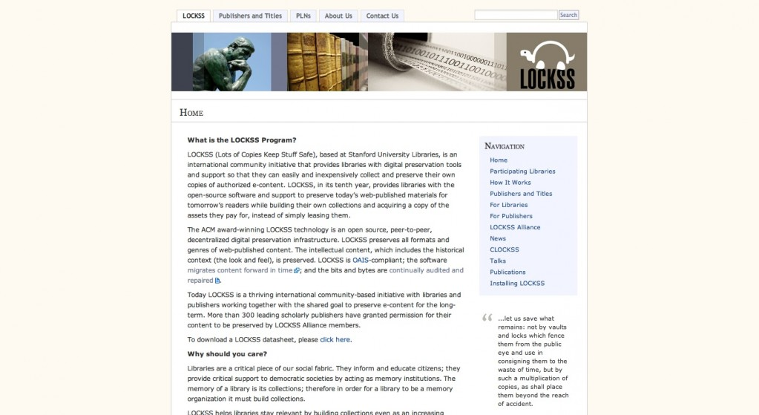
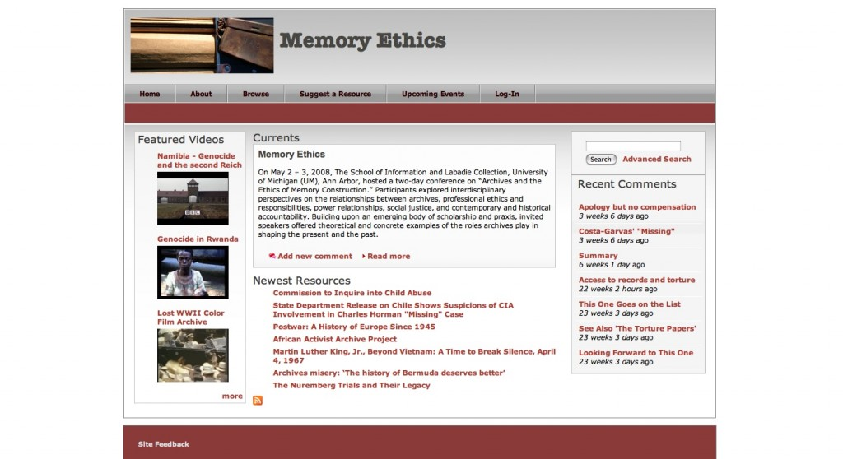
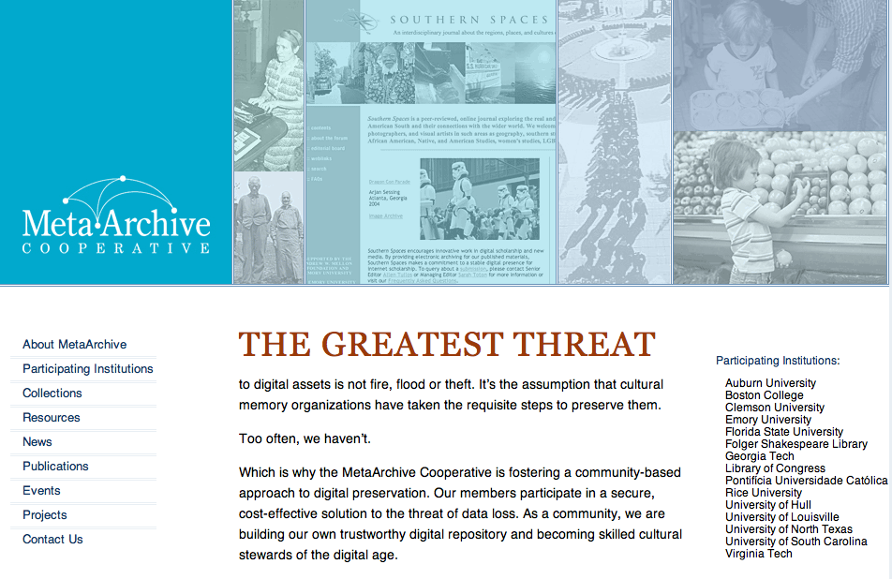
Auditor Background
MSI 2009
University of Michigan
School of Information
http://mgschultz.com
MetaArchive 2010
*
Notes:
*

Slide 4
LOCKSS Lots of Copies Keep Stuff Safe
Open source software-driven preservation solution that makes use of networked storage servers
Public LOCKSS Network
Publishers & Libraries
E-Content Preservation
Scholarly journals
Websites
Blogs
http://lockss.org

Slide 5
MetaArchive Cooperative
Private LOCKSS Network (PLN)
Archives, Libraries, & Museums
Cultural Memory Collections
Electronic Theses
Digitized Photographs
Digitized Manuscripts
Extending LOCKSS
http://metaarchive.org

Slide 6
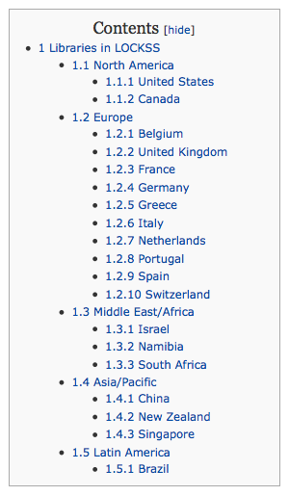
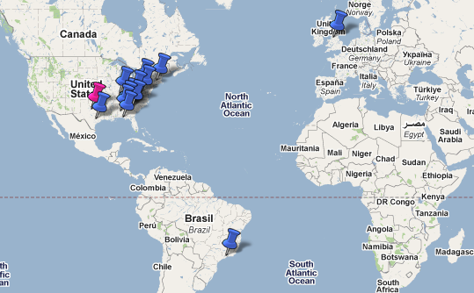
LOCKSS Defining Qualities
Geographic Distribution
LOCKSS
Locations
MetaArchive
Locations

Slide 7
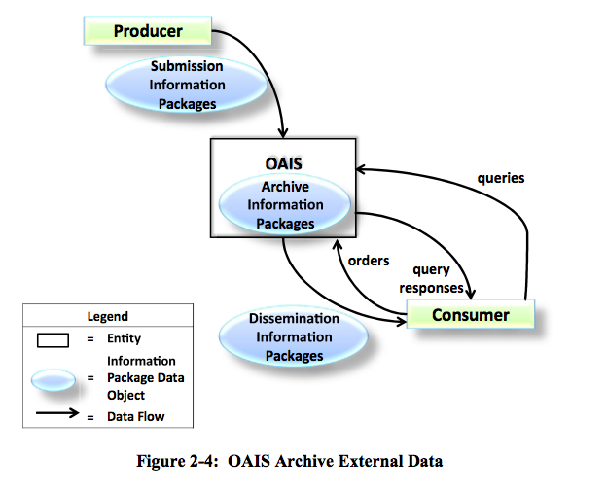
LOCKSS Defining Qualities
Push vs. Pull

Slide 8
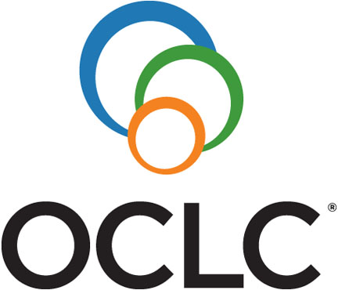
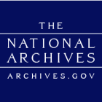
Trusted Repositories Audit &
Certification (TRAC)
Background

Slide 9
Trusted Repositories Audit &
Certification (TRAC)
Freely available self audit tool
Designated communities
Conformance in three major areas:
Organizational Infrastructure
Digital Object Management
Technologies, Technical Infrastructure & Security

Slide 10
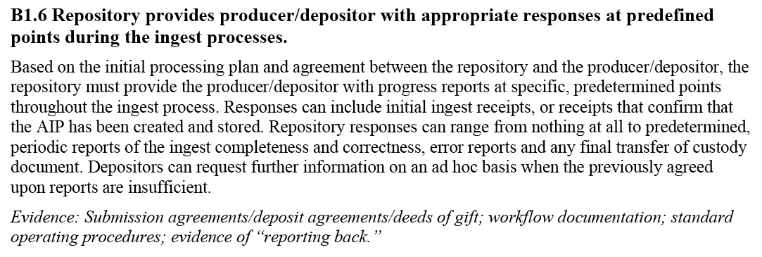
Trusted Repositories Audit &
Certification (TRAC)

Slide 11
Trusted Repositories Audit &
Certification (TRAC)
http://wiki.digitalrepositoryauditandcertification.org/bin/view/Main/WebHome

Slide 12
TRAC Audit - Process
When to proceed?
Design Stage
Developmental Stage
Operational Stage
Who is involved?
Senior Management
Policy Makers
Technical Staff
Information Specialists
Designated Communities

Slide 13
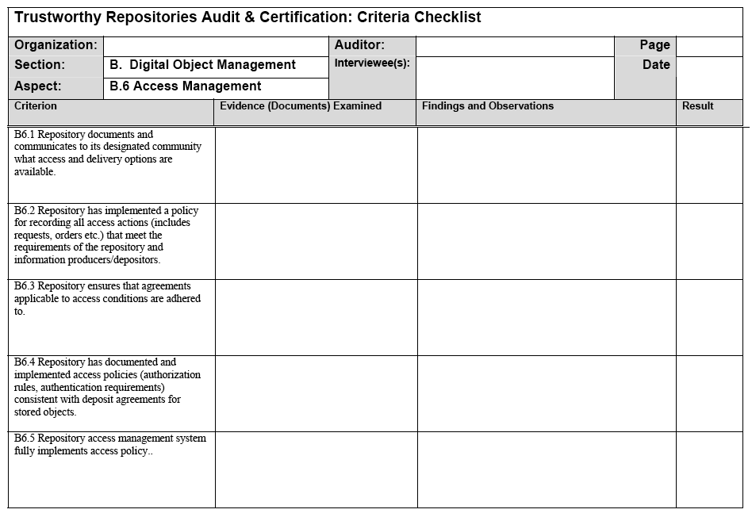
TRAC Audit - Process
How does it proceed?
On-site visits
On-site inspections
Interviews with key staff
Remote correspondence
Document exchange
Access to tools

Slide 14
TRAC Audit - Lessons Learned
Preparation
Investigation
Discussion

Slide 15
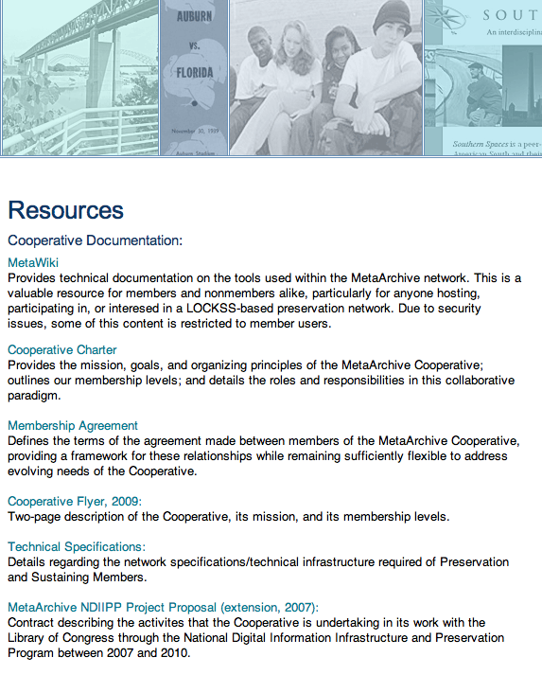
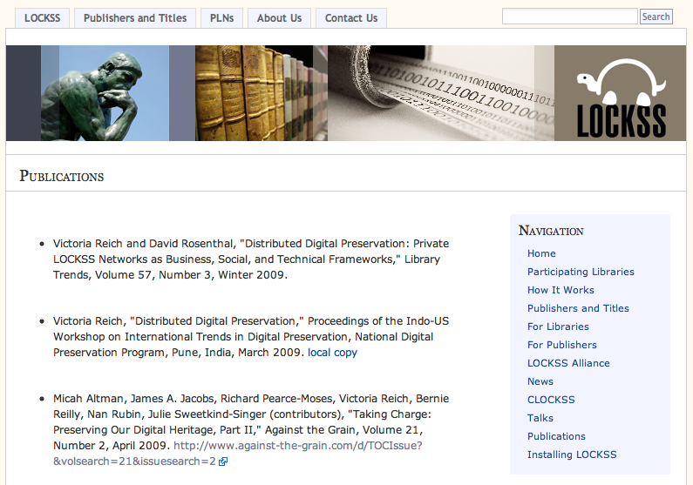
TRAC Audit - Preparation
Review the repository documentation

Slide 16
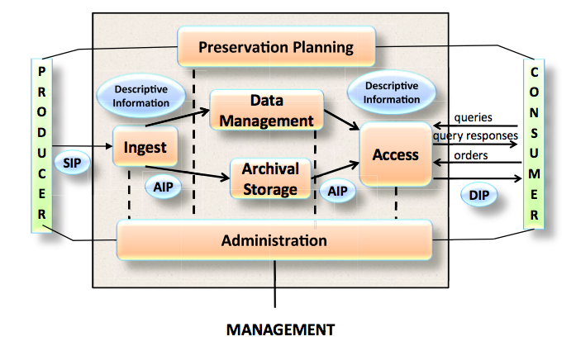
TRAC Audit - Preparation
Review the standards (OAIS)
http://public.ccsds.org/publications/archive/650x0b1.pdf

Slide 17
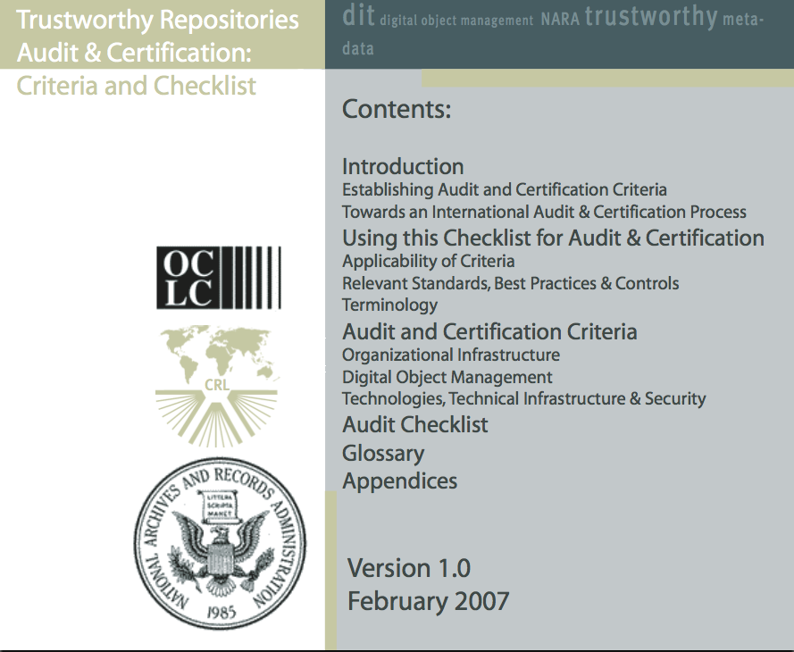
TRAC Audit - Preparation
Review the audit tool (TRAC)
http://www.crl.edu/sites/default/files/attachments/pages/trac_0.pdf

Slide 18
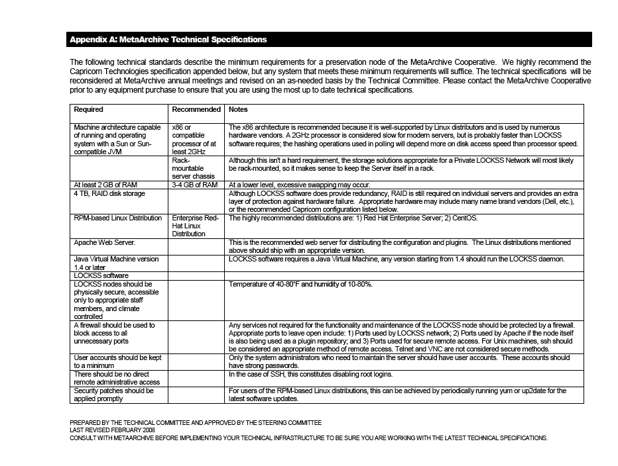
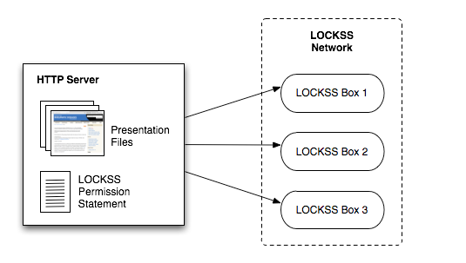
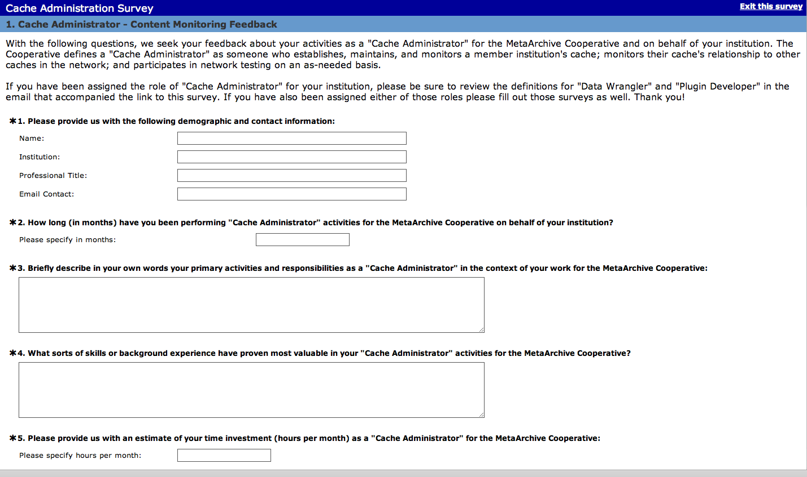
TRAC Audit - Investigation
Critique the processes & documentation

Slide 19
TRAC Audit - Investigation
Critique the standards and auditing tools
Such definitions are not immutable nor should they purport to be
Public LOCKSS Network
Ingest feedback - publisher/library model turns the reference model slightly on its head
MetaArchive Cooperative (PLN)
Access requirements - “dark archive” approach is less accounted for in TRAC and harder to map 1-to-1

Slide 20
TRAC Audit - Discussion
New Implementations
Responses to Standards and Best Practices
Audit Outcomes and Reporting

Slide 21
Questions?
Thank You!
For further information contact:
LOCKSS
Program Director, Victoria Reich
650-725-1134
vreich@stanford.edu
MetaArchive Cooperative
Program Manager, Katherine Skinner
404-783-2534
katherine.skinner@metaarchive.org

