Slide 1
MetaArchive of Southern Digital Culture: A Practical, Working and Replicable Approach to Preservation
Martin Halbert, Emory University
Gail McMillan, Virginia Tech
Tyler Walters, Georgia Tech
Aaron Trehub, Auburn University

Slide 2
Introduction to the MetaArchive of Southern Digital Culture
Martin Halbert
Director for Library Systems
Emory University
CNI Fall 2006 Task Force Meeting
Washington, D.C.
December 4-5, 2006

Slide 3
The Problem
Preservation of digital content is an enormous problem, too big for individual institutions to solve in isolation
We realized that we needed a way to work together cooperatively on this challenge, but there was a dearth of effective models for how to do this

Slide 4
MetaArchive Project Summary
Six partner institutions collaborating with LoC to develop a Cooperative Network for the preservation of digital content in targeted cultural heritage subject domains
(One of the eight NDIIPP partnership projects)

Slide 5
Project Goals: 2004-2007
Conspectus of digital content held by the partner sites
Harvested body of the most critical content to be preserved
Model cooperative agreement for ongoing collaboration
Distributed preservation network infrastructure for replication based on the LOCKSS software

Slide 6
MetaArchive Network

Slide 7
Key Features of a Secure MetaArchive
A collaboratively maintained archive of archives (a meta-archive) is a new concept to be modeled
Our group advocated seven principal attributes of such a system in the project plan preamble
These key features were identified in the planning process that led to the project

Slide 8
#1: Distributed Preservation
Effective preservation succeeds by distributing copies of content in secure, distributed locations over time
This preservation network is based on a leading preservation software package for distributed digital replication (LOCKSS), establishing from the beginning a distributed means of replicated archives

Slide 9
#2: Flexible Organizational Model
The project has developed a relatively simple and flexible cooperative agreement as a model for other institutions seeking to cooperate for purposes of digital preservation.
Agreement entails minimal overhead, enlist straightforward mechanisms for collaboration, and is widely applicable to many sorts of institutions.
Fundamentally, a commitment of institutions to preserve each others’ content

Slide 10
#3: Content Selection
A shared interest in preserving targeted types of content is what brings groups together to collaborate
The subject domain conspectus for digital content was guided by a group of content experts from the partner libraries
The team evaluated content at the partner sites in terms of its importance for cultural heritage, and preservation considerations (including formats and planning for subsequent migration)

Slide 11
#4: Migrating Archives
Factors laying the basic groundwork for
subsequent migration efforts:
Metadata concerning the archived content must be carefully maintained
Selecting migratable formats and data structures
Open source software, so that the software itself can be preserved and evolved

Slide 12
#5: Relatively Dark Archiving (to start with)
Our philosophy decouples the needs of long-term preservation from those of presentation, access, and high availability
Our initial scope is long-term preservation, avoiding the expense and effort associated with the other needs
Information about MetaArchive contents is available publicly through our conspectus database

Slide 13
#6: Relatively Low Cost
This approach to digital preservation is intentionally designed to require minimal expenditures by collaborating groups of medium sized institutions
Building on the LOCKSS approach of low-cost, low barriers to adoption, our preservation network is a model that can be easily implemented by many ad hoc groups of collaborating institutions

Slide 14
#7: Self-Sustaining Incentives
Our cooperative addresses sustainability issues in two ways
Provides participating institutions with a capability that they fundamentally lack individually
Plan to offer pricing models for additional institutions to participate without requiring technical infrastructure

Slide 15
Simple Preservation Exchange Mechanisms
The distributed and automated approach of this project to digital preservation simplifies the mechanism for sharing the resulting archive of digital content with the Library of Congress and other preservation networks
Validated, ongoing replication of the exact content of the MetaArchive at the Library of Congress is ensured by the design of the system.

Slide 16
Project Successes
Feb 2005: Conspectus completed
May 2005: Network in operation
Aug 2005: Initial archiving completed (ongoing)
Feb 2006: Cooperative model analysis completed
Aug 2006: Cooperative Charter drafted
Oct 2006: Nonprofit host organization formed
2007: Collaborative workshops for others interested in LOCKSS VPNs, extension of project

Slide 17
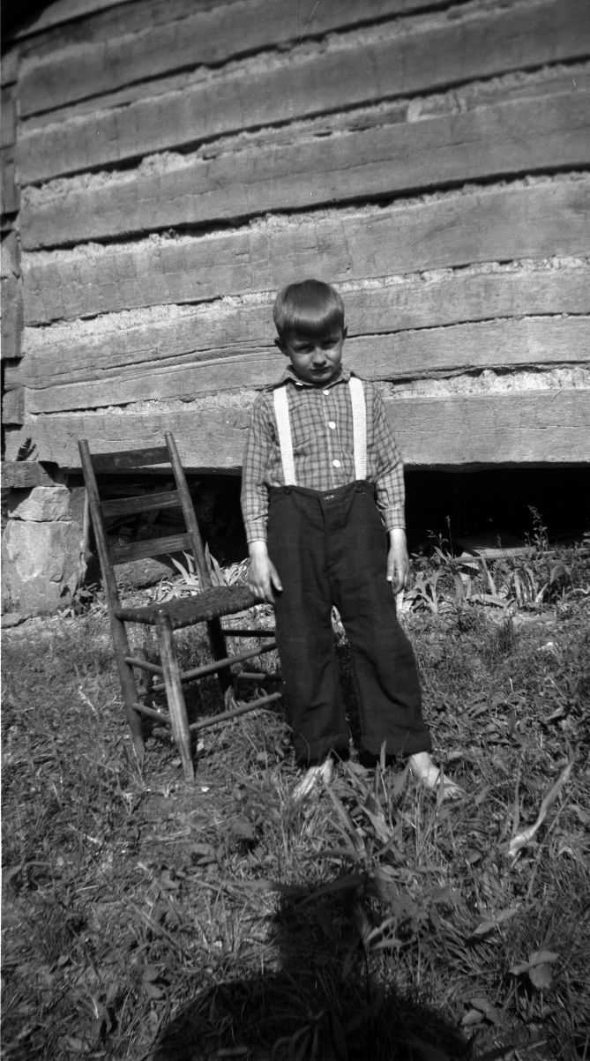
The MetaArchive’s Collections: Decisions and Descriptions
Gail McMillan
Director, Digital Library and Archives
Virginia Polytechnic Institute & State University
CNI Fall 2006 Task Force Meeting
Washington, D.C.
December 4-5, 2006

Slide 18
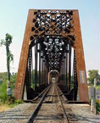
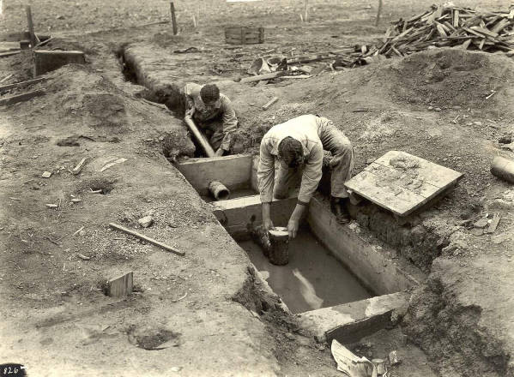
Planning the MetaArchive Conspectus
Scope
Standards
Schema
Controlled vocabulary
Database and Conspectus
Inventory of Collections
Formats
Prioritizing
At risk
Data wrangling
Adapting LOCKSS
Rights Issues

Slide 19
Scoping the MetaArchive’s Content
Southern digital cultural heritage
Broad topics
Not just the Civil War
Slave Narratives
Civil Rights Movement
Business, industry, and technological development
Music
Crafts
Church histories
Encyclopedia of Southern Culture
Local decisions

Slide 20
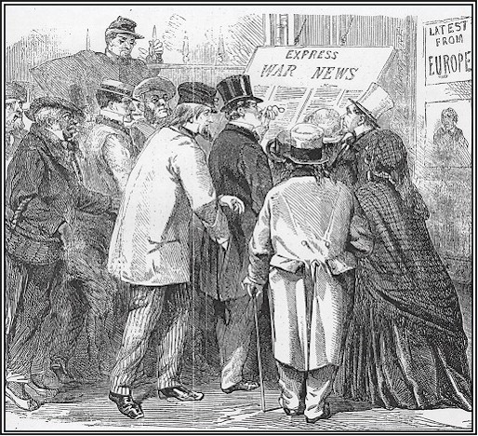
MetaArchive Conspectus Database
Describes the collections to be preserved
Provides information for
Storage estimates
Format migration
Accrual rules
Location
Ownership
LOCKSS specific elements

Slide 21
Genesis of the MetaArchive’s Metadata Specifications
Dublin Core
Collection Level
Description
Dublin Core
Elements &
Refinements
MetaArchive
Metadata
Specification
RSLP Collection
Level Description
MODS
Physical Description
MetaArchive
Specific
Elements

Slide 22
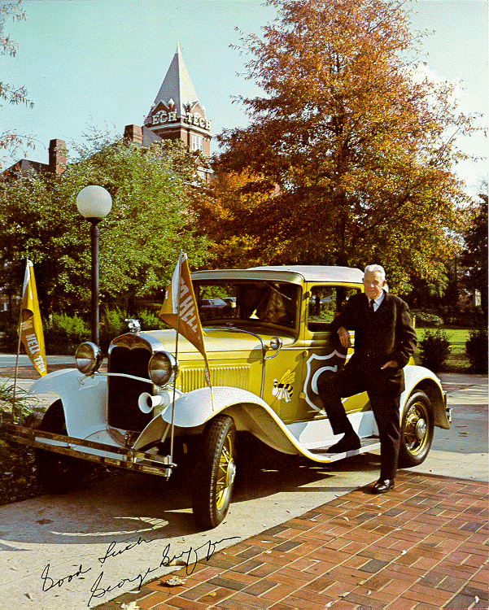
MetaArchive Collection-Level Conspectus Metadata Specification http://metaarchive.org/pdfs/conspectus_md_2005.html
Notes:
Metadata
RED = Collection Level Description
BLUE = MetaArchive Specific Description

Slide 23
MetaArchive Conspectus Database
Auburn: 4 collections/7.9 GB
Extensions pubs, yearbooks (+TIFFs)
Emory: 10 collections/23 GB
Born digital (Southern Spaces), image masters
FSU: 3 collections/101 MB
Juvenile lit, historic photos, 2004 theses
Georgia Tech: 12 collections/809 MB
Digitized special collections, SMARTech, ETDs
Louisville: 3 collections/17 GB
Oral histories, image masters
VT: 50 collections/1.9 GB
Bio DB, online exhibits, faculty archives, digital Spec Coll

Slide 24
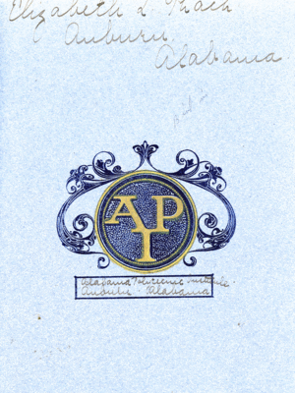
Risk Analysis
Auburn: Glomerata TIFFs
Risk Rank: 3
Risk Factors: …stored on a single server at Auburn, with backup copies on multiple DVDs.
Emory: Nunn’s emails
Risk Rank: 2
Risk Factors: … part of the Electronic Data Center's collections… The master file (restricted) needs to be maintained along with the access file (open for research.)
FSU: campus photos
Risk Rank: 2
Risk Factors: Images are in a transitional location... They are at risk of degradation, loss due to no systematic, periodic integrity verification processes at this time.
Notes:
LOCKSS IS FORMAT AGNOSTIC, it provides redundant replication of files in any format.
The format is, therefore, not a factor in risk ranking.

Slide 25
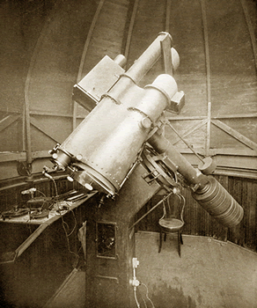
Risk Analysis
Georgia Tech: ETDs
Risk Rank: 5
Risk Factors: Born digital material
Louisville: interviews
Risk Rank: 3
Risk Factors: Masters exist only on CD. Analog originals are on audiocassette (i.e., also at risk).
VT: digital image database
Risk Rank: 5
Risk Factors: This is THE source of digital masters for all official scanning done for teaching, research, and historical preservation.

Slide 26
Adapting LOCKSS: Digital Collections are not like EJournals
LOCKSS ejournal model
Expects stable Archival Units
Completed volumes do not change
Digitizing Special Collections
Changing Archival Units
Not yet scanning entire collections
ETDs don’t even fit the ejournal pattern
Annual academic cycles
Born-digital: Completion date vs. Accessible date
Scanned theses/dissertations: as they circulate
Notes:
.

Slide 27
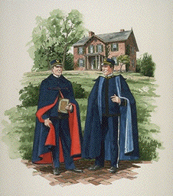
Rights Issues for the MetaArchive
Fit “fair-use” doctrine or other provisions relating specifically to library copying and other activities
Determine whether the work still enjoys protection or has lapsed into the public domain
Occur as a result of valid permission from the copyright owner(s)

Slide 28
Rights Issues for the MetaArchive
Constitute an acceptable risk for the institution in the potential absence of “clear” resolution
Group or individual definitions?
Some more risk averse than others?
Who will decide?
Dark archive--less risk of infringement?
In the spirit of Sect. 108, US Copyright Law

Slide 29
The MetaArchive’s Current Working Environment
Tyler Walters
Associate Director for Technology and Resource Services
Georgia Institute of Technology
CNI Fall 2006 Task Force Meeting
Washington, D.C.
December 4-5, 2006

Slide 30
Current Developments
Testing the Network: Disaster Recovery
We will:
Focus on three components: Hardware, Content (LOCKSS), Network
Simulate crashing primary node
Intentionally damage content (truncate files)
Disable access to plug-ins
Run routine tests for “bad disk,” cache manager, conspectus database, yum repository, kickstart script, xml config. file, etc.
Then:
Reconstruct primary node, resurrect network, reconstruct content
Create documentation on these three items

Slide 31
New Services / New Members
Contributing Partners – cultural memory institutions that possess digital content to preserve via MetaArchive Preservation Network. They contribute fees for this service, they do not operate a node.
Fee Structure / “Pricing”
MetaArchive Cooperative services to members
Digital preservation (network dev./maintenance, content ingest/retrieval)
Format migration
Digital collection disaster recovery
Digital preservation network consulting / training
LOCKSS services
Adding New Members
Issues / practical steps, MoU, technology adherence, funds, collection profile, etc.

Slide 32
MetaArchive and Educopia Institute
Non-profit management entity – Three issues:
1) Continuing need for financial resources
2) Expose MetaArchive to new digital projects to inform development
3) Economically efficient, catalytic structure to bring these about
Educopia Institute:
Provide oversight to MA Cooperative and other digital projects
Low-cost, low overhead conduit for digital library, scholarly communications technology projects
Advance cyberinfrastructure needed to drive research, teaching and learning in contemporary digital era
NSF (2003) and ACLS (2006) Cyberinfrastructure reports:
Scholarly activity – teaching, research, learning, knowledge transfer via scholarly communications – need rational, strategic cyberinfrastructure
EI: Generate DL technology projects to support mission and goals

Slide 33
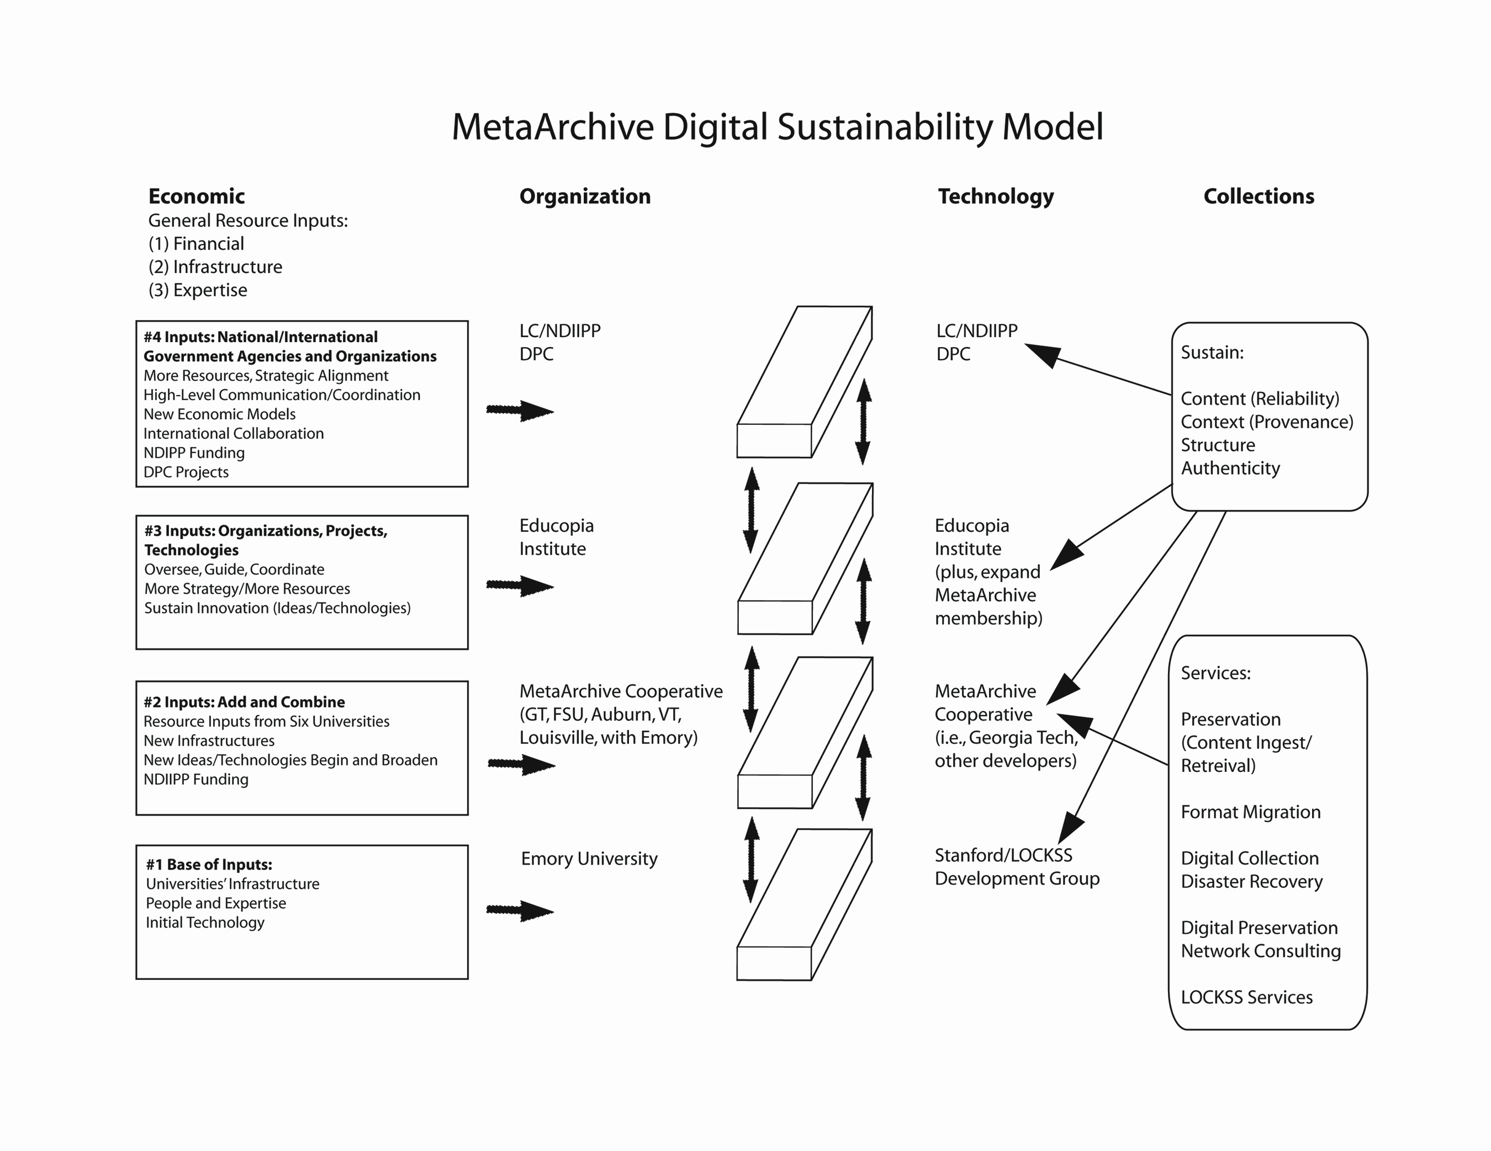

Slide 34
Drafting the MetaArchive Cooperative Charter
Aaron Trehub
Director of Library Technology
Auburn University
CNI Fall 2006 Task Force Meeting
Washington, D.C.
December 4-5, 2006

Slide 35
Episodes
1: The Assignment
2: Getting Started
3: Models?
4: First Pass: Fall-Winter 2005
5: Second Pass: Spring-Summer 2006
6: In Which Things Get Complicated
7. Enter the Educopia Institute
8: The End Product: Fall-Winter 2006
9. Questions

Slide 36
1: The Assignment
Cooperative agreement = one of the project’s deliverables
Mission: to draft, from scratch, an agreement that will govern and sustain the cooperative’s ongoing activities—and serve as a model for other projects
Principles:
Clarity
Simplicity
Flexibility
Openness
Sustainability

Slide 37
2: Getting Started
“Cooperative Agreement Analysis Plan” (CAAP) prepared in August 2005
Six-member working group formed
Editing tasks divvied up
20 questions (what, who, how, how much, etc.)…
…Organized into 5 categories: preparatory, cultural/philosophical, organizational, financial, technical

Slide 38
3: Models?
CIC OAI-PMH MoA
ExLibris Users’ Constitution
InCommon Federation Operating Practices and Procedures
TEI Bylaws and Prospectus
Selected language from the MetaArchive proposal

Slide 39
4: First Pass: Fall-Winter 2005
Rough draft of cooperative agreement and MoA posted to MetaArchive wiki in late September 2005
Four sections: Introduction; Partnership; Organization and Governance; Financial and Economic Sustainability, plus appendices
Editing via e-mail and in weekly conference calls, with input from the working group and the larger collaborative
Extensive contributions from Caroline Arms (LC), Gail McMillan (Virginia Tech), and Tyler Walters (Georgia Tech)
Revised drafts posted to wiki in October-November 2005

Slide 40
5: Second Pass: Spring-Summer 2006
Status check and on-the-spot editing at in-person meeting in February 2006
Further editing by project PI, Martin Halbert (Emory)
Agreement begins to take on more-formal character
Legal review: consultants at the University of Louisville and a private firm in Atlanta

Slide 41
6. In Which Things Get Complicated
Sticky Issues:
Indemnification and liability
Copyright
Exiting the cooperative
Non-compliance and breach of contract
Sanctions
Money
Cooperative Agreement ⬇Cooperative Charter
One-page letter of agreement ⬇Multipage Memorandum of Understanding (MoU)

Slide 42
7. Enter the Educopia Institute
Non-profit organization, created in October 2006 in Atlanta
Provides administrative services for the MetaArchive Cooperative, including:
Billing member organizations for annual dues;
Maintaining and distributing such funds;
Organizing and hosting annual meetings of MetaArchive members;
Holding members accountable for completing agreed-upon tasks;
Hosting workshop programs on digital preservation topics.

Slide 43
8. The End Product: Fall-Winter 2006
The MetaArchive Cooperative Charter and MoU will address:
Membership
Duration and cost
Governance structure
Conditions of breach
Liability issues
Final editing by Katherine Skinner (Emory), working with lawyers at University of Louisville and private law firm in Atlanta
Finished versions available by early 2007

Slide 44
Draft cooperative charter and MoU
Draft charter available at http://www.metaarchive.org/pdfs/MetaArchiveCharter0906.pdf
Memorandum of Understanding still being drafted; expected in early 2007
Will require review by legal counsel

Slide 45
9. Example of effective partnership…
The drafting process involved various constituencies:
MetaArchive members
Colleagues at other institutions
Administrators at other institutions
Legal consultants
Successfully mixed virtual and in-person editing
Approximately one year from start to finish—not bad for a complex legal document

Slide 46
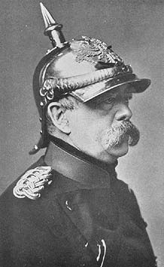
…Or tour of the sausage factory?
“Laws are like sausages.
It's better not to see
them being made.”
(Otto von Bismarck)

Slide 47
Answer: Well, yes
Pluses
Effective collaboration among different constituencies and institutions
Effective drafting process (eventually)
Difficult questions resolved or at least broached
Not-so-pluses and “known unknowns”
Departure from original conception
Additional complexity
Institutional buy-in remains to be seen

Slide 48
The Verdict
Fulfilled one of the project’s deliverables
A more-complex-than-anticipated instrument that nevertheless could be adopted (and perhaps whittled down) by other projects
So: a qualified success that needs now to be tested in practice

Slide 49
Thank you! Questions re the MetaArchive?
Aaron Trehub
trehuaj@auburn.edu
(334) 844-1716
Tyler Walters
tyler.walters@library.gatech.edu
(404) 385-4489
Gail McMillan
gailmac@vt.edu
(540) 231-9252
Martin Halbert
mhalber@emory.edu
(404) 727-2204

