Slide 1
Towards Coherence through
Collective Action:
Laying the Foundation for Sustainable, Open Infrastructure
Katherine Skinner, Educopia
Heather Joseph, SPARC
Maurice York, University of Michigan
Evviva Weinraub, Northwestern University

Slide 2
OVERVIEW
Three coordinated initiatives to talk about:
Invest In Open Infrastructure (IOI) Open Platform Initiative Mapping Scholarly Infrastructure Census
Outline for the conversation:
Framing: Mission and Vision Overview of the Initiatives The Niche For Action Open Questions, and Conversation Direction and Next Steps
Notes:
Maurice - remember to talk about “overview of the initiatives”--introduce them--Census is about “what have we created”, IOI and Open Platform are about “what can we do to change it?”. IOI is global, Open Platform is local

Slide 3
SIGNS OF THE TIMES In just the last few months...
Lyrasis and DuraSpace merger by July 1, 2019
Hampshire College potential insolvency - desire to merge
UC system breaks Elsevier contract - make knowledge open
MySpace server migration - loss of all content, 2003-2015
Notes:
Maurice

Slide 4
THE SCHOLARLY INFRASTRUCTURE CONTEXT
Commercial acquisitions of key infrastructure & new policy mandates: Question of control/ownership of scholarly infrastructure in the spotlight
Platforms, tools & systems critical to the full research lifecycle are Increasingly vulnerable to exclusive commercial provision
Numerous “siloed” projects that may or may not work with each other, with inconsistent funding, function, goals….
Notes:
Heather

Slide 5
THE SCHOLARLY INFRASTRUCTURE CONTEXT
Significant gaps in understanding:
Who are the players? What are their motivations? Whose interests are being served, and what is left out? What does the landscape look like now, and what have we created?
Notes:
Katherine

Slide 6
THE RISK OF INACTION Who controls knowledge? What is saved? Who gets to see what, and on what terms? Who decides?
Imbalance between academy-owned and commercial infrastructure (Privatization of Public knowledge)
Siloed behavior in a networked, interdependent world (Loss of national / international competitiveness)
Increasing waste and redundancy (Loss of resources & credibility)
Inability to serve as effective stewards of the scholarly & cultural record (Loss of relevance, integrity & trust in our knowledge institutions)
Notes:
Maurice & Heather
Funders are telling us to work together

Slide 7
ANSWERING THE CALL TO ACTION Open, Community-controlled Infrastructure to Support Open Access to Knowledge in the Public Interest
This space needs a game-changer - There are many examples of working efforts to point to & learn from But many have observed the gaps & challenges over the years
There is an opportunity to rethink community investing strategies - Funding agencies & institutions are looking beyond one-offs
There is a narrow window to construct & support a comprehensive framework for collective action to impact the broader ecosystem at global scale
Notes:
Evviva
So, in our discussions, we all agreed, we needed a new way of framing how this might work.
We have examples of efforts to point to and work from that have highlighted the gaps and challenges to creating collective community spaces.
We’ve all been investing in projects like Vivo, DuraSpace, Fedora, DPN, APTrust, Software Preservation Network, Samvera, Fedora, Islandora, IIIF, DSpace, etc. Etc.
We know that many of our community investors are sick of paying $10k here, $5k there. We know that the agencies that have funded our projects are telling us to look beyond assuming they will always be there to fund our projects as we move from “innovation” to “maintenance.” We are taking this as an opportunity to rethink how we, as community investors, spend our money as we try to create something that is around supporting sustainability and interoperability.
If you’ve heard Heather talk about the multi-trillion dollar industry that the content providers are hoping to bank on as they move into the data analytics business we recognize that there is a there is a narrow window to construct & support a comprehensive framework for collective action to impact the broader ecosystem at global scale.

Slide 8
NOW IS THE CRUCIAL TIME: STRATEGIC, COLLECTIVE ACTION AT SCALE
A different model, based in different thinking
Embracing a global consciousness: A structured “network of communities and alliances” (Align towards interdependence)
Enabling a coherence approach: Structural elements to ensure interoperability & integration (Relate the parts to the whole)
Enacting sustainable fiscal stewardship: Reinvesting & being responsible with limited resources (Pool the risk & manage investment)
Notes:
Evviva
We are trying to approach this from a different angle than we have in the past. We’re attempting to embrace this from a global perspective - we recognize that we are a series of communities and alliances, some of which are interoperable, and interdependent.
We are looking to build a coherence approach where we use the structural elements of our various projects to ensure interoperability & integration.
Finally, we’re hoping to create a
Enabling a coherence approach: Structural elements to ensure interoperability & integration (Relate the parts to the whole)
Enacting sustainable fiscal stewardship: Reinvesting & being responsible with limited resources (Pool the risk & manage investment)

Slide 9
Mapping Scholarly Communication Infrastructure
Notes:
Handoff to Katherine

Slide 10
CONTEXT: Mapping Scholarly Communication Infrastructure
PROJECT GOALS
To map the range of infrastructure that comprises the system of scholarly communication (Census underway)
To survey colleges and universities to understand their current investment practices in this infrastructure (Forthcoming)
Principal Investigators: Mike Roy, David Lewis
Consultants: Educopia Institute, TrueBearing Consulting
Generously funded by: The Andrew W. Mellon Foundation
Notes:
This project is engaged in re-thinking how higher education invests in the creation, publication, dissemination, consumption, and preservation of ‘content’.
I’m Katherine Skinner, and I’m the lead consultant on this project. The project’s PIs are Mike Roy (Middlebury) and David Lewis (emeritus dean, IUPUI).
The project explores how higher education and all of its schol comm stakeholders might move towards a system that is (1) more if not completely open (2) more affordable (recognizing that the scholarly communication system will never be FREE) and (3) takes advantage of the affordances of ‘the digital’ to re-think what counts as scholarship and the scholarly record.
To accomplish this, we’re undertaking several project activities, including the two listed here: mapping the range of infrastructure elements comprising our system of scholarly communication, and surveying colleges and universities to understand their current investment practices in this infrastructure.
The project is focused on improving our system-level view of the wide variety of tools, services, and communities engaged in scholarly communications.
Today, I’m going to share a bit more about the “Census” which we’re working on now, including some early-early phase, hot-off-the-drafting-table visualizations of the initial data we’ve gathered.
Advisory Committee
John Dove, Kathleen Fitzpatrick, Rachel Frick, Mike Furlough, Robert Miller, Heather Piwowar, Vanessa Proudman, Judy Ruttenberg, Roger Schonfeld, Brian Schottlaender, Yasmeen Shorish, Kevin Stranack, Greg Tananbaum, Dan Whaley,

Slide 11
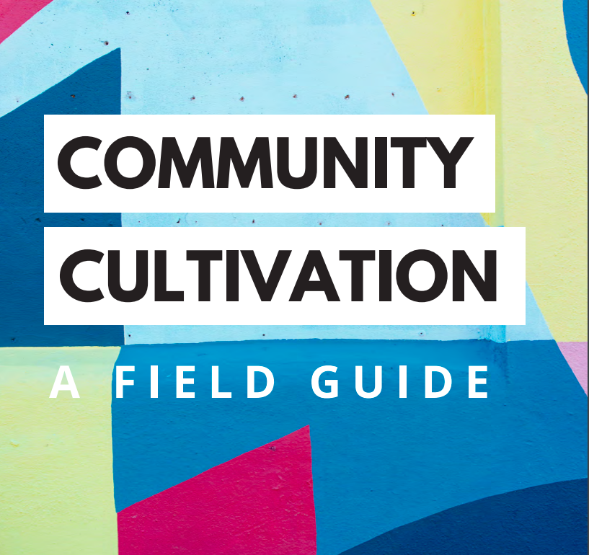
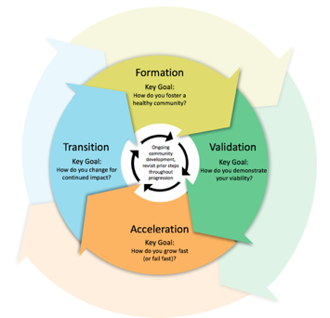
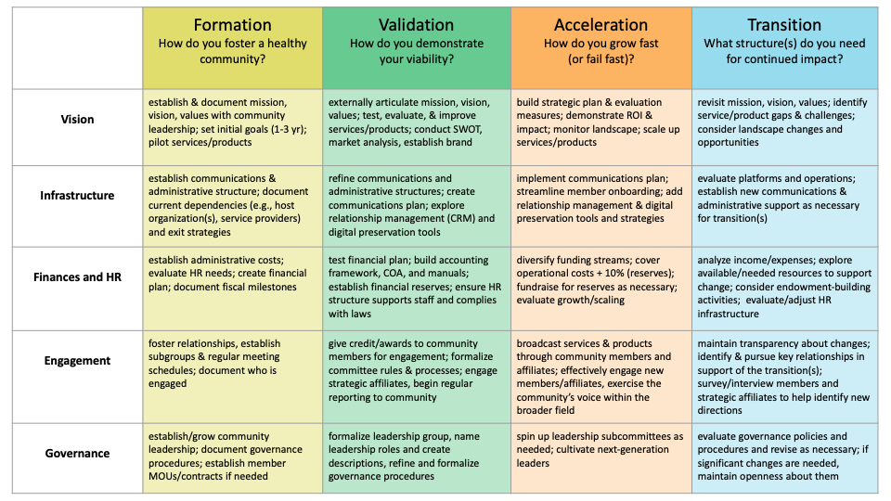
Foundations for the Census
CCFG Purpose: To help communities assess their current strengths and growth opps, then pinpoint appropriate tools and activities to assist in their maturation.
Census Purpose: To gather and assess info about the SCR’s organizational, technical, fiscal, administrative, governance, engagement, and HR/staffing activities in order to better understand individual SCR stability and to establish a health index for SCRs via the aggregated data.
Community Cultivation Field Guide available at: http://educopia.org/cultivation (free and open)
Notes:
But first, how did we design the Census?
The Backbone for the Census: Educopia’s Community Cultivation Model, which has guided our work at Educopia with a wide variety of communities and organizations for the last 12 years. We published a “field guide” last year to bring our community development research and findings and advice to a broader audience, beyond the 24+ communities that we have worked with. If you’ve not yet encountered it, please visit the link listed on the slide, or just go to Educopia.org and you’ll find it on our homepage.
The CCM helps communities to assess factors that we’ve found influence the sustainability and health of a broad range of “communities,” which we define as “an intentional collective of people who gather to address common interests and goals, and who are empowered to govern and guide development of the services, tools, and resources they produce.” These range from unfunded volunteer efforts to both nonprofits and for profits with established revenue and service models.
We used the CCM to ground the Census and to identify what types of organizational, technical, fiscal, administrative, governance, engagement, and HR/staffing questions we could reasonably pose and reliably use to assess the overall health/stability index of both individual SCRs and the aggregate (our schol comm system).
Using the results of the census and inventory, we are creating pilot visualizations of the system of scholarly communication.

Slide 12
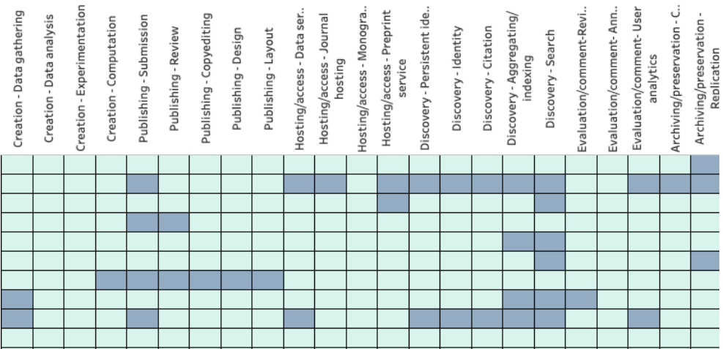
Census, early data visualizations
NOTE: The link to the full instrument is available on the project website from the following page:
https://scholarlycommons.net/map/
Census was open from Feb 18-Mar 22
45 respondents
25+ additional respondents have indicated interest and will be included late
SCR 1
SCR 2
SCR 3
SCR 4
SCR 5
SCR 6
SCR 7
SCR 8
SCR 9
Notes:
So with that background in place...there are a few disclaimers I have to make. First, these are VERY EARLY visualizations--the PIs just saw these for the first time today as well. They are not meant to be production ready right now. These are just “teasers” if you will, to let you see the types of things we’re hoping to be able to better understand with this data.
The Census was run over a six-week total period: Census dates: Feb 1- 15 (pre-group), Feb 18-Mar 22 (roughly 1 month)
45 full responses to date
25+ additional respondents have expressed interest and will be included late
This data is only part of what we’re collecting in the project. We’re complementing this content with case studies (in-depth conversations with SCRs about their development), and we’re also conducting a survey of libraries (to understand what they’re investing in currently) and focus groups with library leaders.
What we are able to see already, just based on the early census data, though, is really interesting. Here, you can see a high-level map that shows the location of individual SCRs, plus a count of the “objects” they have produced or are hosting. Below that map, you can see an early graph that shows in blue what scholarly communications activities a single SCR provides or focuses on--creation tasks like data gathering or experimentation, publishing tasks like review and layout, hosting and access activities like journal hosting or data services, discovery work around citation or aggregating/indexing, etc. This just shows the first 10 of the initial 45, scrambled and anonymized. You can start to see the range of activities different tools and services concentrate on.

Slide 13
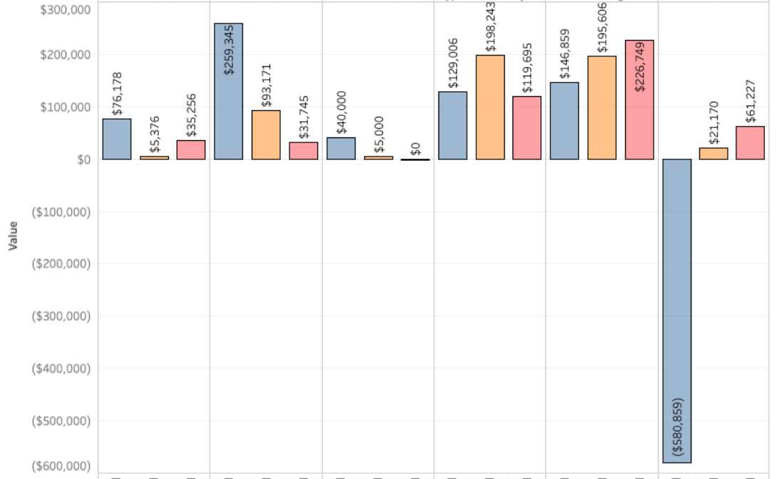
Example data
SCR 1 | SCR 2 | SCR 3 | SCR 4 | SCR 5 | SCR 6
This graph shows fiscal variance between net budgeted and net actual for six of the surveyed SCR’s.
In mature SCRs, we would hope to see relatively stable, near zero amounts--not at all what we see here.
2016 2017 2018 | 2016 2017 2018 | 2016 2017 2018 | 2016 2017 2018 | 2016 2017 2018 | 2016 2017 2018
Notes:
Here, we’re looking at deeper information about the fiscal stability of SCRs. Again, this is a random sample of 6 SCRs, anonymized. Each COLUMN is an SCR, and each of those columns contains 3 bar graphs that correspond to the fiscal variance--or the difference between the NET BUDGETED (what money they expected to receive and spend) and the NET ACTUAL (what money they really received and spent)--in three discrete years. The blue is 2016 in each column; the orange is 2017, and the pink is 2018.
What’s striking to us about this (and holds true when we look across the 45 respondents) is how high the variance is between what an SCR budgeted and what an SCR actually received and spent. In a mature system, we would expect to see relatively stable, near zero amounts, year over year. That’s not at all what we see in the data we’ve gathered. Correlating this information with other questions--including about grant funding and other less-predictable forms of funding--will help us zero in on some of the reasons for these deviations.

Slide 14
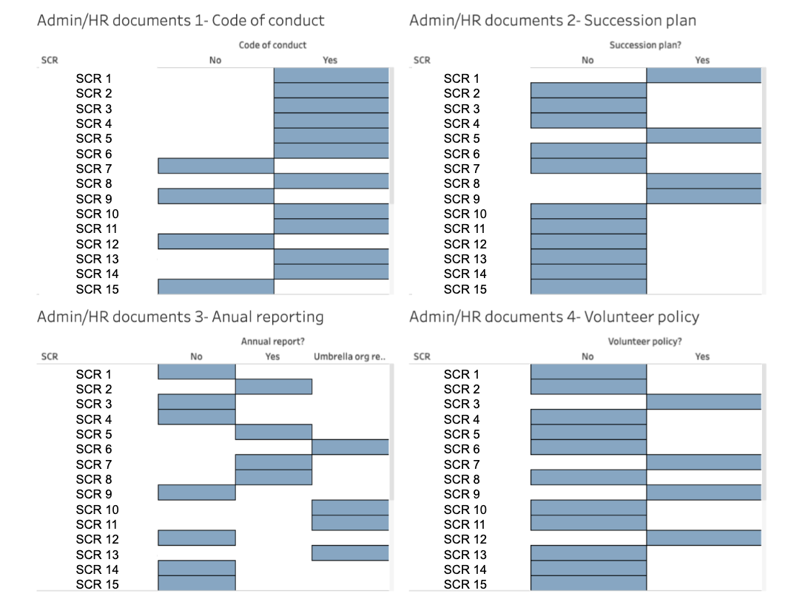
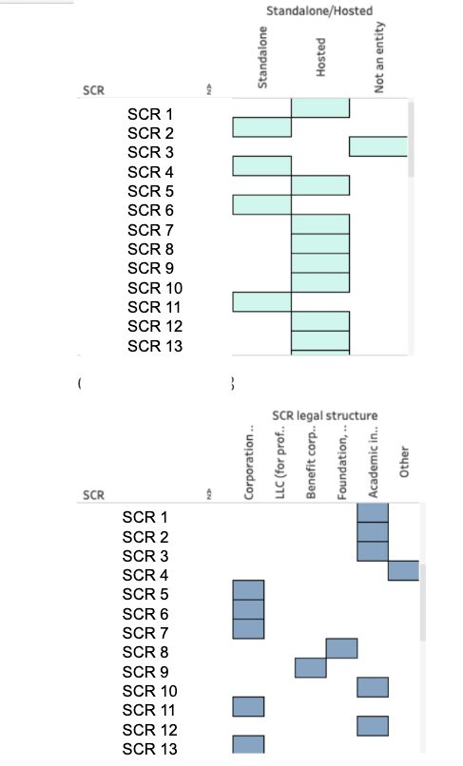
Example data
Administrative - Succession Plan
Organizational structure
This graph shows organizational and administrative info reported by 15 SCRs.
Questions probed organizational, technical, fiscal, administrative, governance, engagement, and HR/staffing activities
Administrative - Annual Report
Legal structure
Notes:
We also asked a slew of questions that probe at the SCR’s organizational and legal structure, and that ask about common forms of documentation.
Here, on the left, you can see anonymized, randomized responses from about 15 SCRs to questions about whether they have a succession plan (documentation charting what happens in a leadership emergency or other crisis), annual report (describing the SCR’s activities and fiscal information in a given year). We’ve found these two forms of documentation--and many others--to be very uneven across the system.
On the top right, you see answers to questions about the organizational structure--are they a standalone incorporated business or are they hosted or are they not an official organization at all.
On the bottom right, you see answers regarding the legal structure of the organization (or its host): is it a corporation? An LLC? A Benefit Corproation or B-Corp? A Foundation? An academic institution?
We are processing a wealth of information regarding what support structures SCRs have in place right now. These are interesting in individual answers; they may be more compelling in aggregate forms, where we’ll be able to better understand the types of funding associated with particular legal or organizational structures, for example, or see if there are correlations between mature fiscal practices and governance practices in SCRs.

Slide 15
What the Census can tell us
What have we created, and what does the landscape look like today?
How are initiatives supported, and how stable is that support?
What are the greatest risks to the infrastructures we are supporting?
How can we improve the ways we build and fund tools and services?
Can we responsibly use this type of information to guide investments?
Notes:
So ultimately, what do we hope the census will be able to tell us that can help our system?
I’ve pinpointed just a few things here, and I’ll say again that we’re in the very earliest stages of data analysis--I just finished normalizing the data last week. We’ll have far more to say and show by this Fall.

Slide 16
Invest in Open Infrastructure
(IOI)
Notes:
Handoff to Heather

Slide 17
CONTEXT: Global Organizations & Funders
Against this backdrop, a host of international non-profit organizations interested/involved in providing open source infrastructure, tools and services to support open, community-controlled scholarly infrastructure self-organized to develop a “Joint Roadmap for Open Science Tools” (JROST) a year ago this month.
While the initial effort focused on facilitating technical collaboration and interoperability across projects, a subset of the group began to meet regularly to explore constructing a large-scale, collaborative, global funding model support and sustain this infrastructure. The result is “Invest in Open” (IOI).
Notes:
Heather

Slide 18
INVEST IN OPEN INFRASTRUCTURE (IOI)
VISION
A community-led global strategic framework on open infrastructure that supports a viable, diverse, efficient, thriving ecosystem to serve as the stable foundation of scholarly communications in the 21st century
MISSION
To enable a durable, scalable, and long lasting open scientific and scholarly infrastructure to emerge, thrive, and deliver benefits on a global scale
DIRECTION
Create a strategic, global body - The Framework - with a mandate to facilitate and shepherd a shared strategy and shared agenda across international stakeholders
Notes:
Heather

Slide 19
IOI - Desired End State
Fully formed, end-to-end, open, community controlled infrastructure to support all aspects of science and scholarship, from research and experimentation through publishing, dissemination and discovery
Sufficient funding to support the evolution, maintenance, operation and support of this infrastructure
Sufficient funding to support the innovation required for new infrastructure as needs and technologies change
Funding from a mix or sources, including scholarly and research institutions (through libraries, research offices, and other budgets), government agencies and private foundations. All supporting open projects that themselves have a mix of sustainability strategies.
Notes:
Heather

Slide 20
IOI: Who are we?
We are an international group of organizations, coalitions and like minded efforts that share mutual goals and in most cases have already been working towards similar objectives. We are coming together under IOI to coordinate and align our efforts in order to get there faster.
We are the Joint Roadmap for Open Science Tools (JROST), OPERAS, Open Research Funders Group (ORFG), Scholarly Commons (2.5% Commitment), SPARC Europe, SPARC US
Notes:
Heather

Slide 21
Open Platform Initiative
Notes:
Hand off to Maurice

Slide 22
CONTEXT: Research Institutions
In the fall of 2018, leadership from sixteen research libraries began organizing conversations around a shared concern. All rely heavily on open source community infrastructure projects to support their preservation and access mission for digital content.
The group aligned around a shared sense of an imminent threat: that the systems, structures, and collaborative networks necessary to support the knowledge ecosystem have reached a level of complexity and scale that has overwhelmed the ability of existing methods of funding, cooperation, and governance to reliably support shared open infrastructure.
The shared imperative that this condition requires immediate, collective action and a commitment to promoting sustainable, interoperable infrastructure resulted in the Open Platform initiative.
Notes:
Maurice

Slide 23
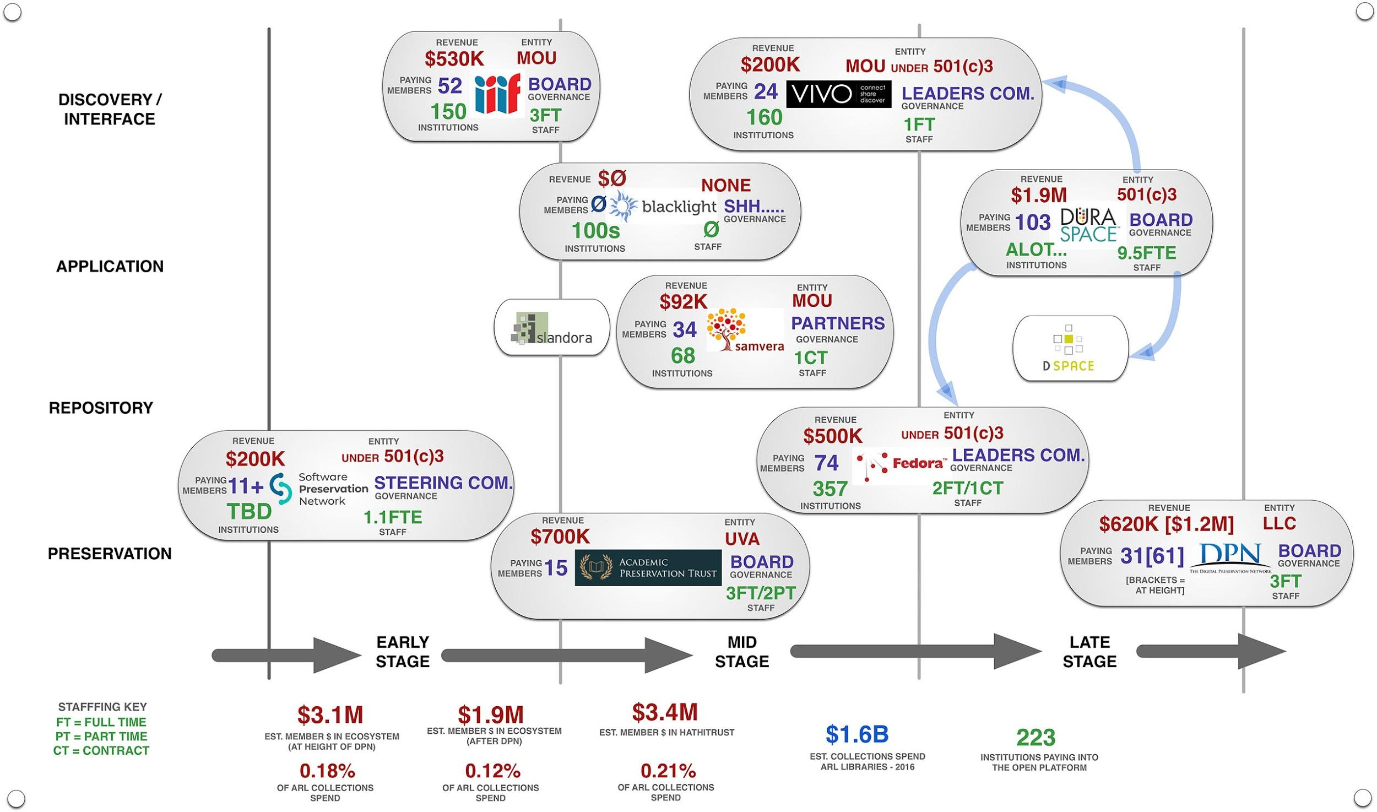
Notes:
Maurice

Slide 24
OPEN PLATFORM INITIATIVE
OBJECTIVE
A coherent, interoperable, and adaptive ecosystem of systems and services under joint stewardship, resting on a foundation of shared understanding, common purpose, and interdependence
Support usable and dependable technologies
Strengthen the health of the communities that create them
Fortify the collaboration of the institutions that use them
PURPOSE
To provide value to a diverse community of higher educational and cultural institutions to safely and continuously steward the digital content integral to academic inquiry, scientific knowledge, and cultural heritage by
Promoting shared capacities and services that enable durability and persistence for content and data
Providing usable discovery and access for users
Building and enabling capabilities for staff to effectively manage and curate the knowledge stewarded by participating institutions
Notes:
Maurice

Slide 25
Open Platform - Desired Future Condition
Through collective action, we seek to create an Open Platform that brings financial, strategic, and institutional coherence to community-built, interoperable, service-driven infrastructure and software projects that support the preservation and access of scholarship and knowledge.
The platform must have an intrinsic, robust capacity to execute, sustain, and scale.
Notes:
Maurice

Slide 26
The Open Platform is not simply a collection of software and tools, but
a fluid ecosystem—
a set of technologies, shared principles, and standards that includes both open and commercial solutions.
STANDARDS,
INTEROPERABILITY
& CERTIFICATION
Develops & Promotes Interoperability Documents the components of the Platform
Maintains Alignment with International Standards
CREDENTIALING
STRUCTURED SERVICES,
PARTNERSHIPS
& ALLIANCES
FISCAL
STEWARDSHIP
& SUSTAINABILITY
PARTNERSHIPS
FUNDING
Cultivates Relationships,
Works for the Whole
Gathers & Distributes Funding & Resources
Reviews & Evaluates Resource Needs
ARTICULATES THE MESSAGE POOLS THE RISK
Notes:
Evviva
Standards
Fiscal Stewardship
Structured services & partnerships

Slide 27
Open Platform Initiative: Who are we?
We are a group of research libraries who are major supporters of and investors in the ecosystem of open source communities and software projects that support the preservation and access of digital content.
These technologies and communities support our individual and collective mission as responsible stewards of the knowledge and cultural heritage in our care. Collectively, we have been building these technologies, in one form or another, for over twenty-five years.
EMORY UNIVERSITY
JOHNS HOPKINS UNIVERSITY
INDIANA UNIVERSITY
PRINCETON UNIVERSITY
UNIVERSITY OF COLORADO
UNIVERSITY OF IOWA
UNIVERSITY OF MICHIGAN
VIRGINIA TECH
NC STATE UNIVERSITY
PENN STATE UNIVERSITY
COLUMBIA UNIVERSITY
OHIO STATE UNIVERSITY
UNIVERSITY OF VIRGINIA
NEW YORK UNIVERSITY
STANFORD UNIVERSITY
NORTHWESTERN UNIVERSITY
Notes:
Evviva/Maurice
We recognize that we’re not the only players in this space.
We’ve reached the point for opening for further conversation & discourse - broad, inclusive initiative.
Looking for input

Slide 28
THE NICHE FOR ACTION
In the mode of coherence, each initiative works alongside of/hand in hand with other momentum and existing efforts.
Each brings a perspective that fills a niche to join with those efforts and strengthen the overall picture
ORGANIZATIONS + FUNDERS + INSTITUTIONS
In other words, we can’t afford to duplicate efforts anymore or indulge in efforts that try to act alone. We must act in concert. This is part of our fundamental premise
Notes:
Evviva
Within the context of both IOI and Open Platform, we’ve done a lot of work thinking about sustainability and inclusivity and diversity of thought, but we recognize there is still room and a place for further conversation and input.
There is a LOT of room to grow for Diversity & Inclusion - but there is room for further input and growth.

Slide 29
OPEN QUESTIONS & THINGS WE DON’T KNOW
What should we be thinking about and discussing in terms of the landscape?
What resonates?
What’s missing?
What would you want to see?
What concerns you?
Notes:
[Not a war of principles--not an extreme that says, Open is the only way or the best way, to the exclusion of all else. This is about bringing balance between the vendor system and the open system]

Slide 30
NEXT STEPS
IOI
Census
Open Platform
Notes:
Evviva

