Slide 1
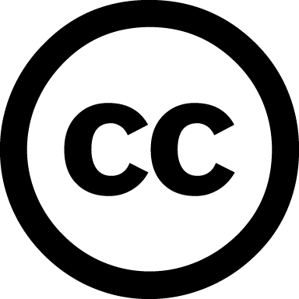

Copyright
Resources
NCA “Best Practices in Fair Use in Scholarly Research” https://www.natcom.org/fair_use.aspx
CAA “Code of Best Practices in Fair Use for the Visual Arts” http://www.collegeart.org/pdf/fair-use/best-practices-fair-use-visual-arts.pdf
Cornell University “Fair Use Checklist” http://copyright.cornell.edu/policies/docs/Fair_Use_Checklist.pdf
US Copyright is a legal tool authors and
creators use to signal what other people
can – or cannot – do with their works.
Public Domain: Works are in the public
domain once a defined period of copyright
protection has lapsed, at which point they
are no longer governed by copyright and can
be freely used by anyone.
If you are using a work that is within copyright,
but meets certain “fair use” criteria, courts
have found that no formal permission is needed.
The criteria that are taken into account include
the purpose (e.g., educational and research uses
favor fair use while commercial uses do not); the
type (e.g., factual or nonfiction-based information
may favor fair use; highly creative work likely will
not); the amount (e.g., small quantities vs. a
significant portion of the original work); and the
effect (e.g., no negative impact on the copyright
holder). http://copyright.gov/circs/circ01.pdf
Giving credit is no substitute for asking permission!
Creative Commons (recommended)
-CC0: a waiver (no license)
-CC-BY: attribution
-CC-BY-ND attribution, no derivatives
-CC-BY-NC: attribution, non-commercial
-CC-BY-SA: attribution, share alike
More: https://creativecommons.org/
What can copyright protect?
literary works
musical works, including accompanying words
dramatic works, including accompanying music
pantomimes and choreographic works
pictorial, graphic, and sculptural works
motion pictures and other audiovisual works
sound recordings
architectural works
What about my copyright?
Copyright for a work you author automatically belongs to you. However, copyright may not extend to research outputs you produce as part of your thesis or dissertation. For example, data is only thinly protected by copyright; specifically designating a CC license to accompany datasets (e.g., CC0) is a good approach for simultaneously sharing and protecting these outputs.
https://educopia.org/research/etdplus

