Slide 1
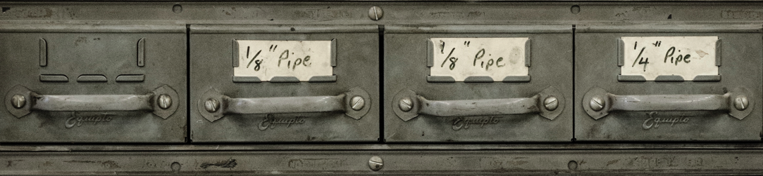

Storage
Basic recommendations:
Maintain at least one local (i.e., non-cloud-based) copy of your content
Maintain at least three separate complete copies of your research content
Maintain at least one copy in a different geographic location
Maintain a history of changes in at least one location (e.g., using a “Time Capsule” software package to automatically back up your content without deleting older copies)
Document in a text file how, when, and where you store and back up your materials
Systematize your folder- and file-name conventions using human-identifiable information
Use naming conventions to mark versions of files, e.g., using consecutive numbers to track a file through all edits and revisions that take place to it. (e.g., filename-v12.txt)
Make sure your filenames are followed by the correct file extension (e.g., .txt, .csv)
Avoid using special characters in all file and folder names (e.g., \?:*?<>{}[]&$,;.!)
Document the formats you are managing and the potential sustainability issues
Save a copy of your research files in non proprietary formats, so that you don’t need a software license to render and use them.
Back-up: A copy of your digital content,
ideally stored in a different location
from the original, usually made to
prevent data loss.
Preservation: The “series of managed
activities necessary to ensure continued
access to digital materials for as long as
necessary”. –Digital Preservation Coalition
Where and how you choose to store
your research materials and writings
will determine how long they survive.
To mitigate against loss, make your
own back-ups on a regular, formalized
schedule (e.g. daily or weekly).
Threats to storage environments:
Natural disaster
Human error
Human malice
Drive failure
Format obsolescence
Media obsolescence
Bit rot
Business failure
Software or hardware error
Advanced recommendations:
Produce and maintain an inventory of all of your content, documenting file names, sizes, locations, and types
Create and regularly check “checksums” or
digital signatures for your most important
research files. Checksums can be generated
by several open source tools and utilities and
they can be stored in your inventory.
Monitor your content to ensure missing, moved, and renamed files are automatically brought to your attention. A tool like “Fixity” can scan specified folders or directories on a regular basis and report changes to you via email.
Resources
For “back-up” advice, see Jesus Vigo,
Best Practices to Back up Your Data
For more on cloud-based backups, please see Charles Beagrie Ltd. How Cloud Storage can address the need of public archives in the UK
For general information, see also Personal Digital Archiving
https://educopia.org/research/etdplus

